Slide 1
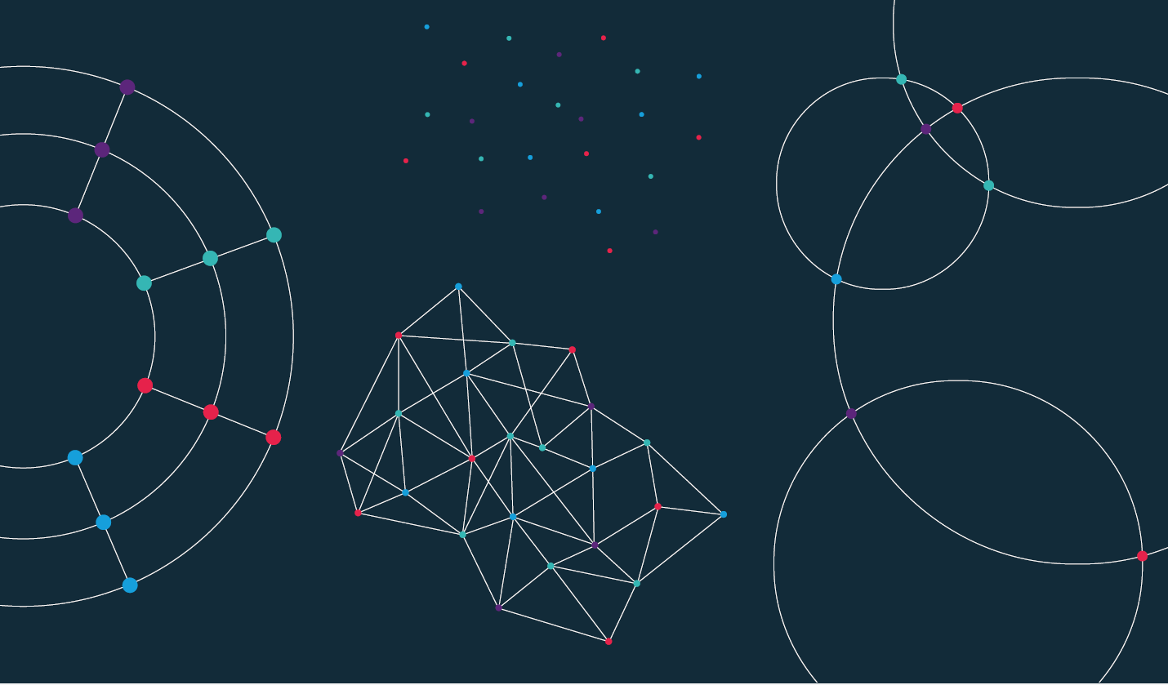

Slide 2
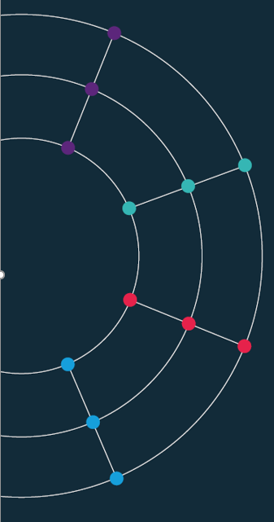
Lecture 4. Accessing data programmatically using APIs

Slide 3

APIs.

Slide 4
What is an API?
Application Programming Interface
An API is software—an intermediary that helps two applications to talk to each other.
They are everywhere: each time you use an app like Facebook or Instagram, send an instant message, or check your weather app on your phone, you are using an API (example: Apple Watch)
APIs are extremely useful to data scientists because they provide a way to share/access data

Slide 5
API guidance.
They all look different but have a similar set up.
A base url: e.g. https://api.stlouisfed.org/fred/series/observations?
A series of options you can choose: series_id= file_type= time_start=
Often a request for your API key: api_key=
Often, when the API requires more information/choices from you, a series of & symbols. An example:
https://api.stlouisfed.org/fred/series/observations?series_id=UNRATE&api_key=22ee7a76e736e32f54f5df0a7171538d&file_type=json

Slide 6
ECO API.
We have made ours as simple as possible.
https://api.economicsobservatory.com/{COUNTRY}/{SERIES}
You just need to add the country (e.g. GBR) and the series (e.g. INFL).
https://api.economicsobservatory.com/GBR/INFL
To get US growth data all you do is change a few letters:
https://api.economicsobservatory.com/USA/GROW

Slide 7
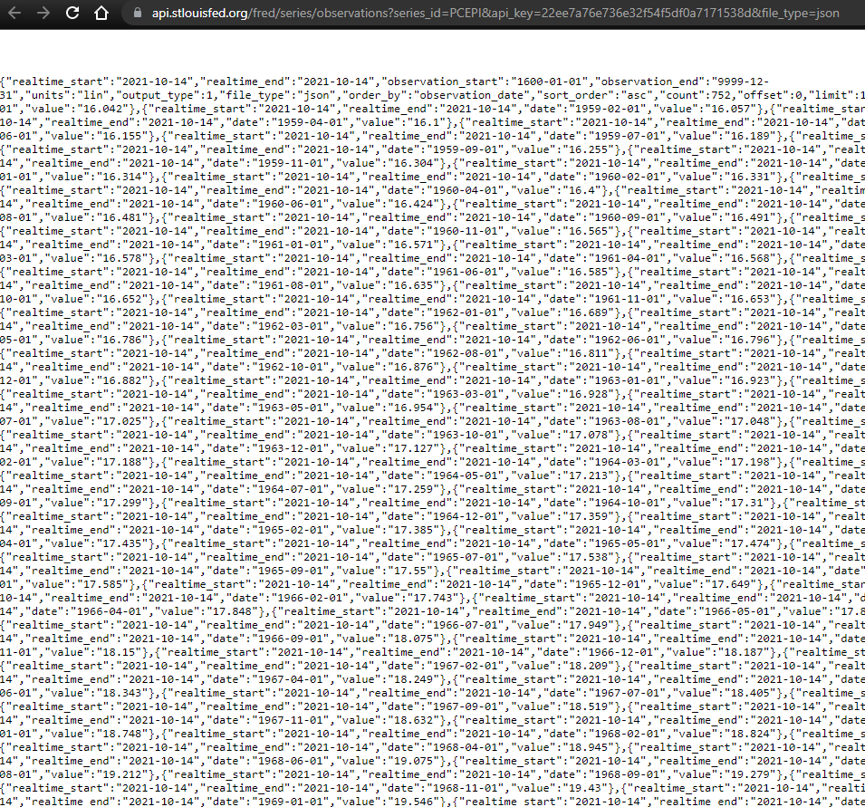
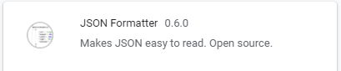
Raw JSON.
Download a JSON formatter plug in for your browser

Slide 8
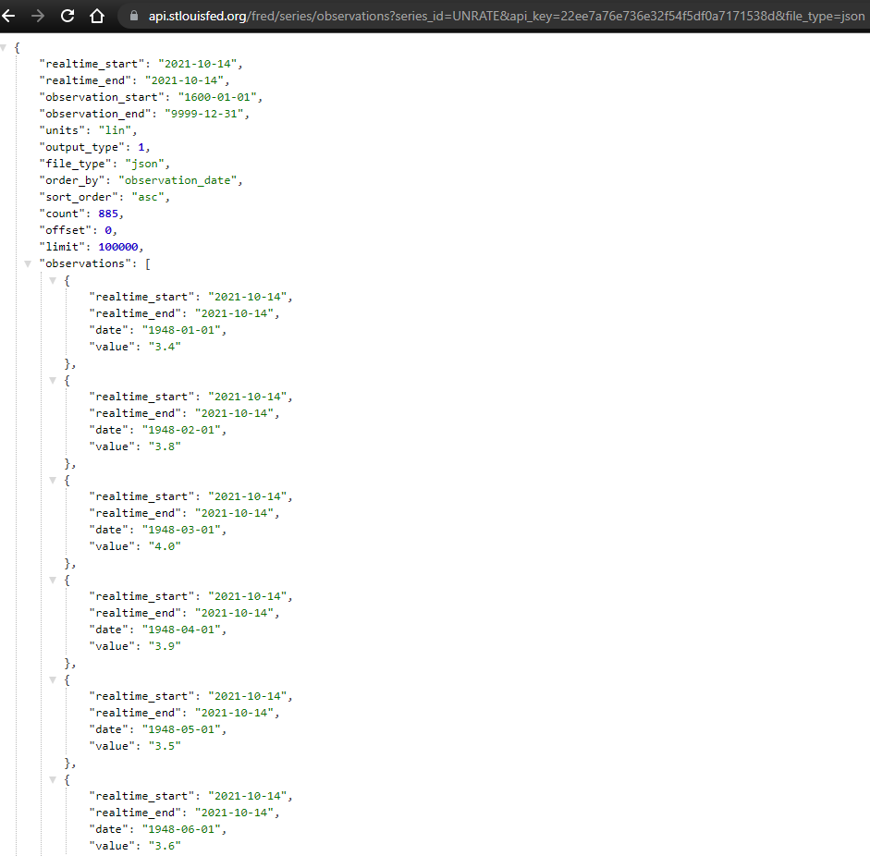

Slide 9
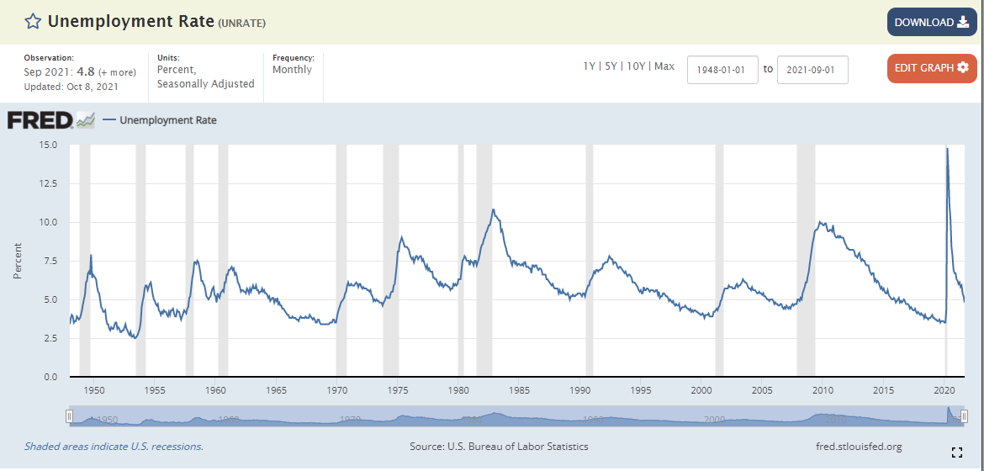

Slide 10
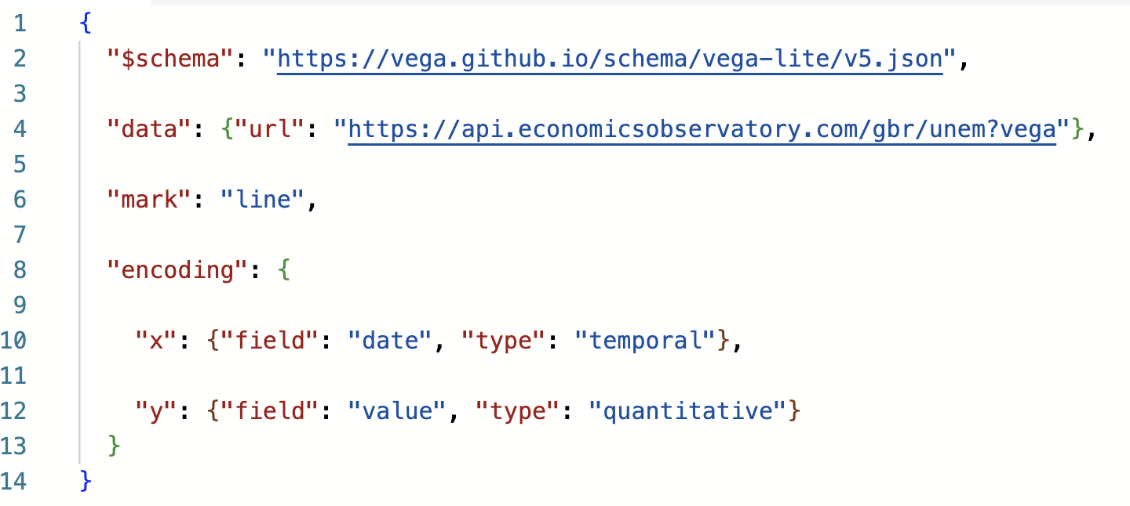
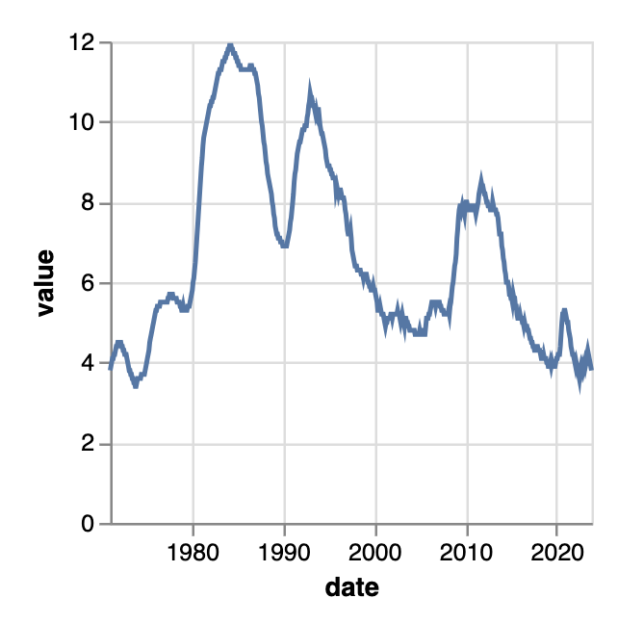
Worked example.
This chart pulls data from the Economics Observatory API:

Slide 11
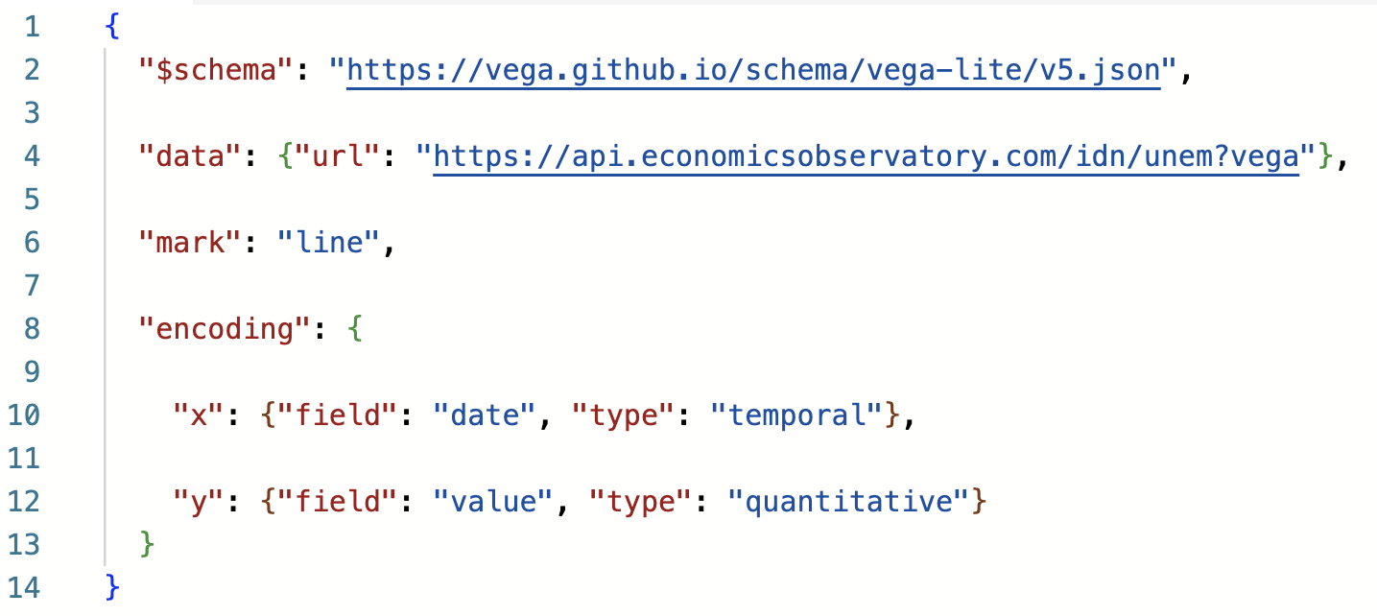
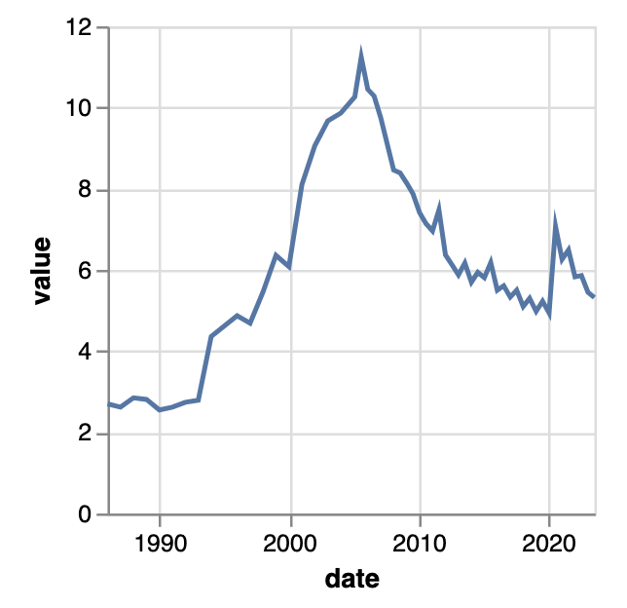
Worked example.
Chart now shows Indonesian data
API URL tweaked
Edit the URL to draw data from a different country:
Notes:
Indonesia

Slide 12
Lecture 4. Getting data programmatically using scraping

Slide 13
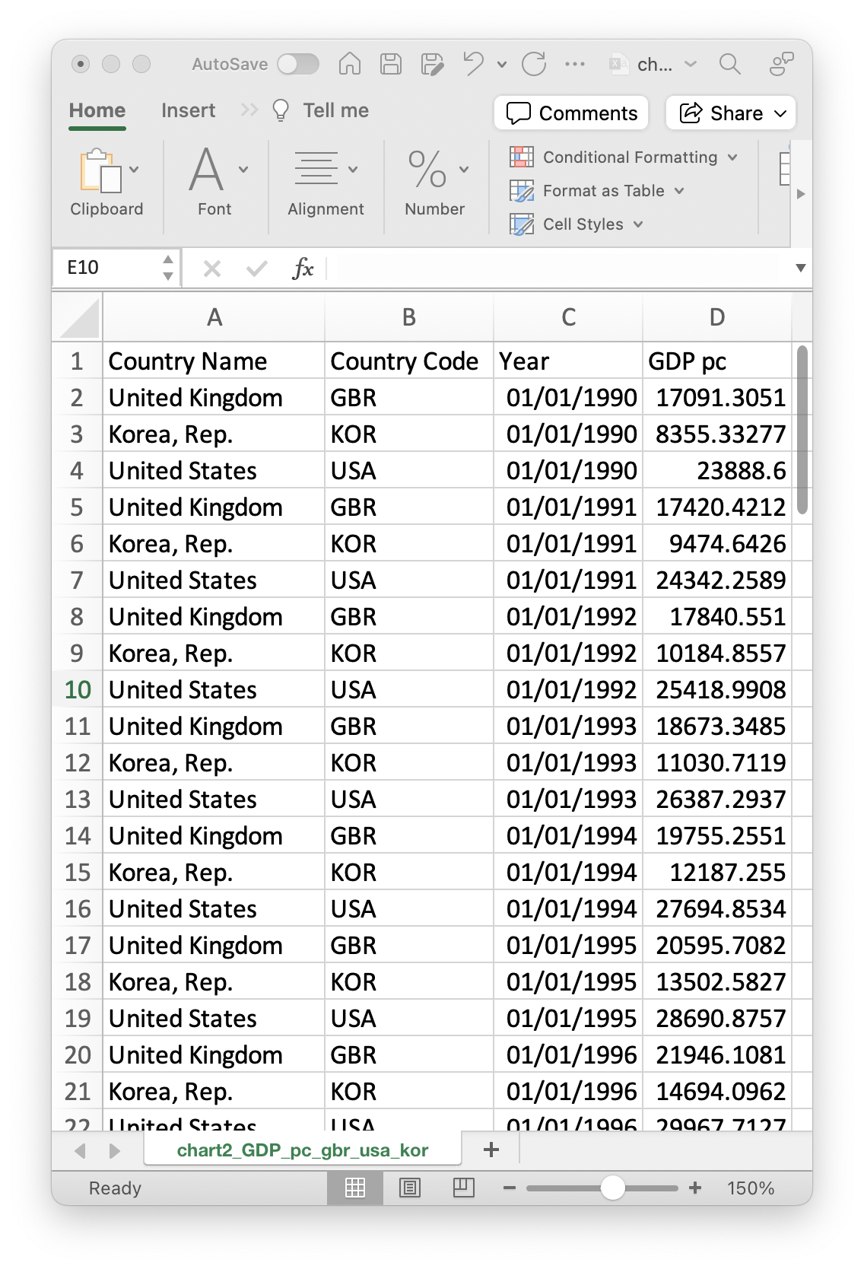
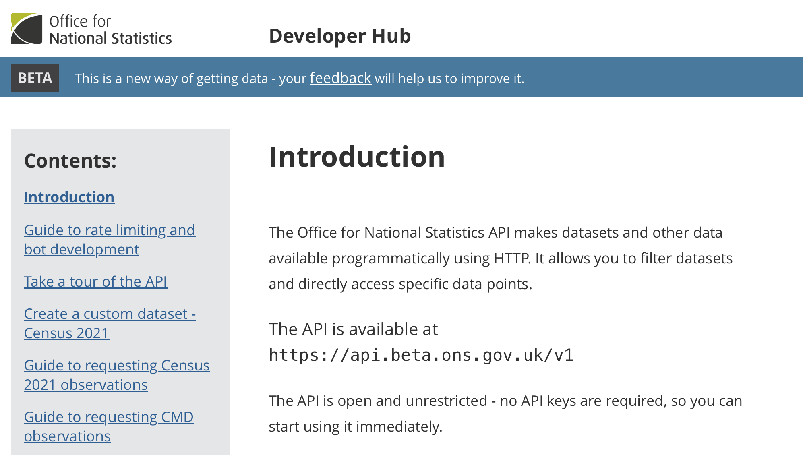
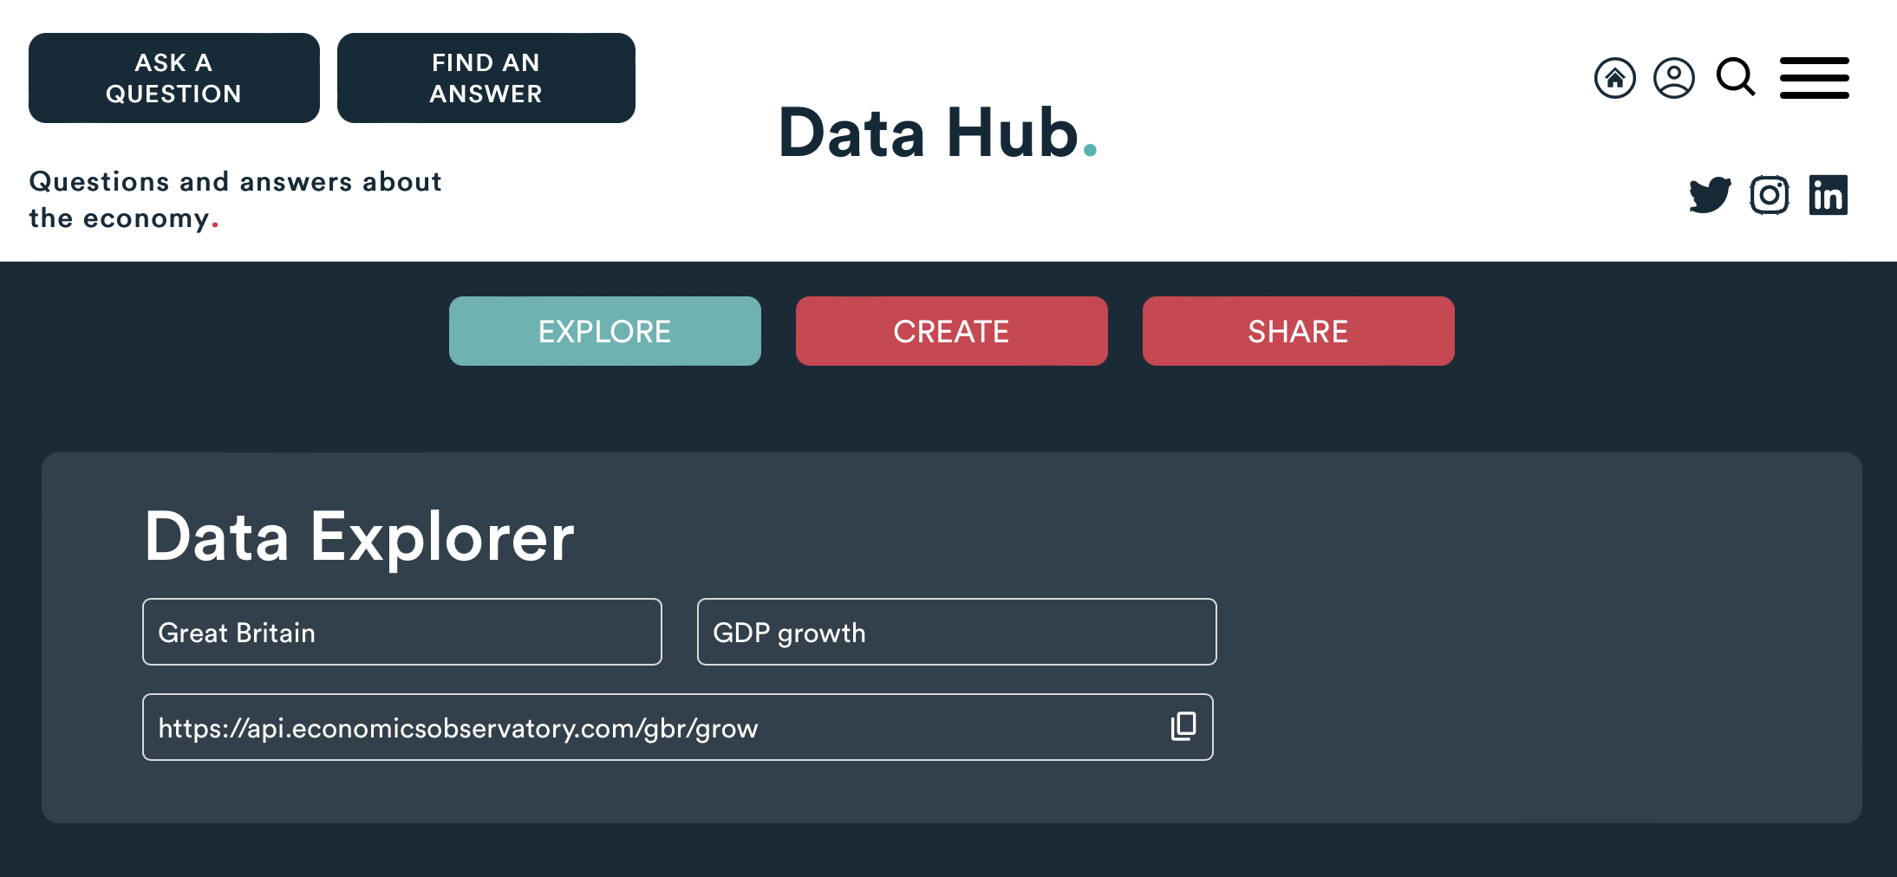
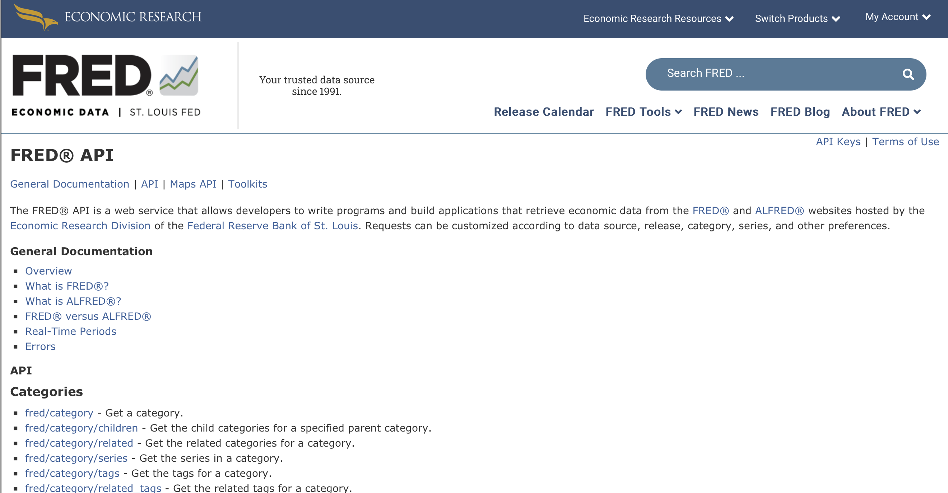
Data, so far...
Today we have used data from
Structured Files
(e.g. Excel, CSV, JSON)
APIs
(e.g. ONS, ECO, FRED)
But what do we do when the data we want isn’t available?

Slide 14
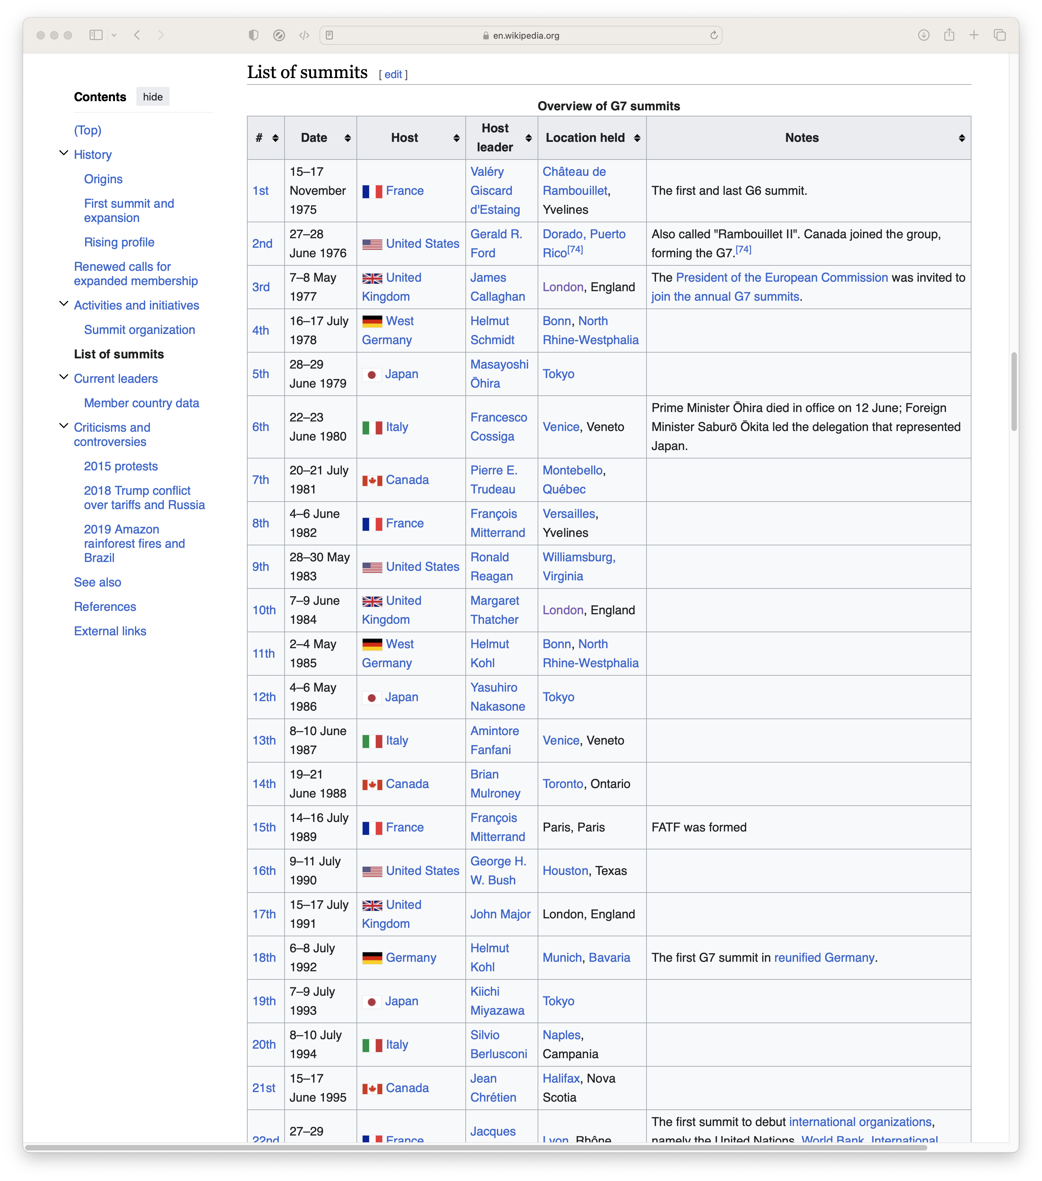
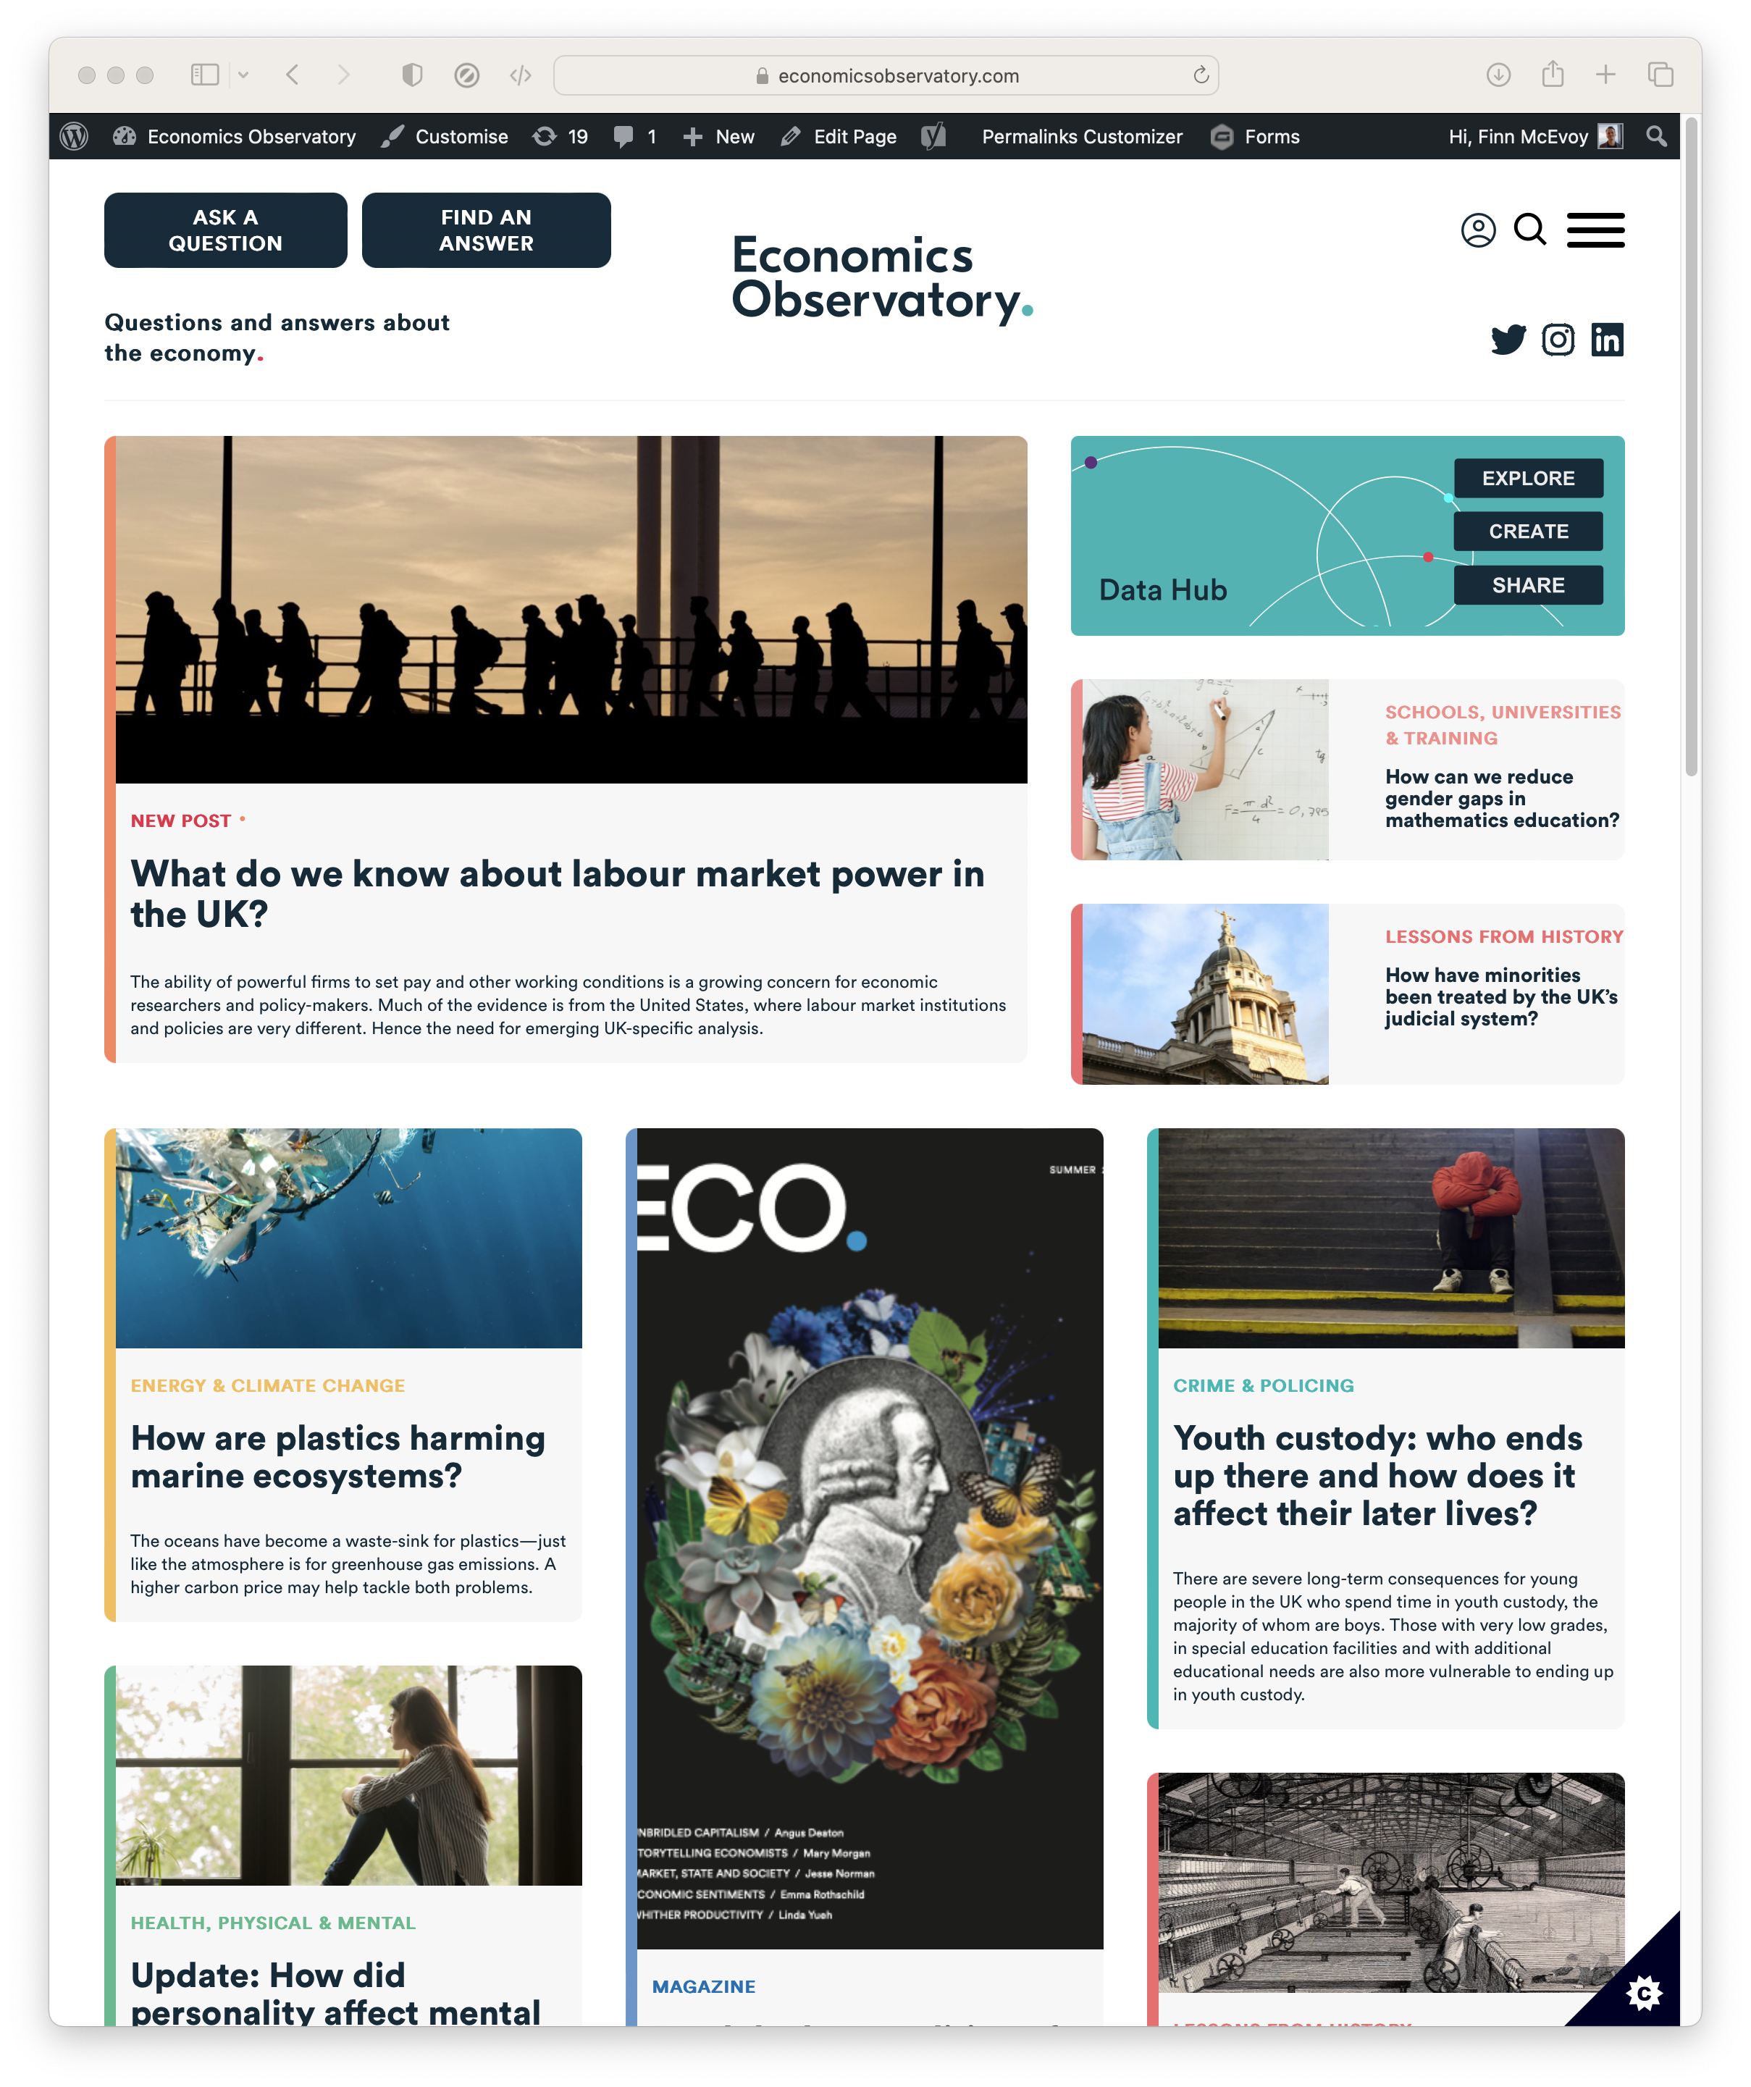
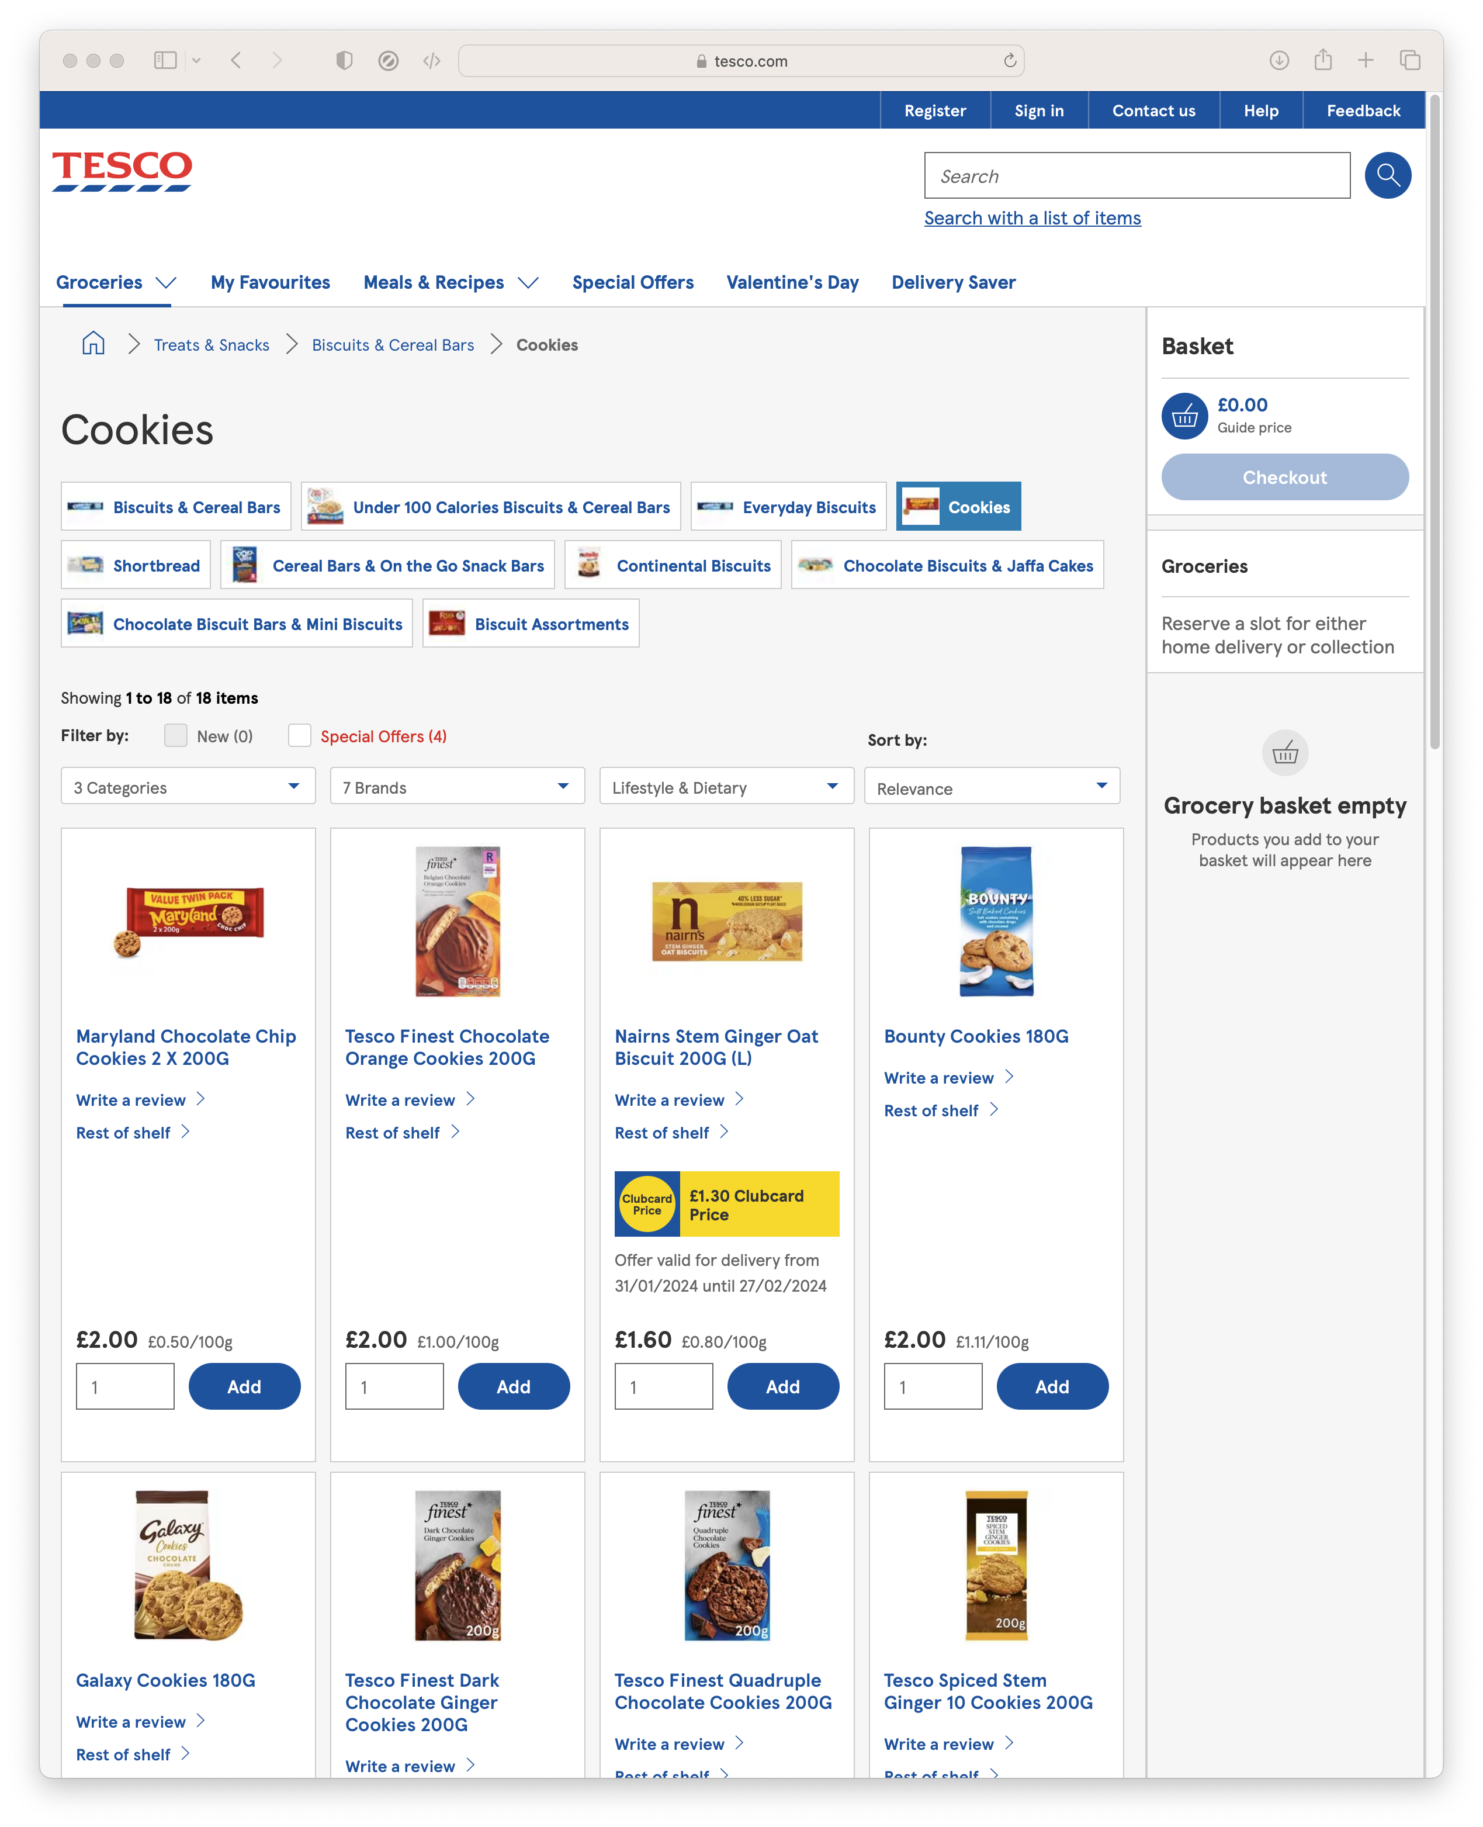
Data, so far...
What if we want
Data from Wikipedia
News and Media
Prices from Supermarkets

Slide 15
Scraping.
The automated extraction of data from websites
Scraping the HTML source. Easy. Automated.
Scraping static HTML pages.
A bit more difficult. Can be automated.
CAPTCHA. Impersonating a human user. Zombie browser.
Scraping HTML pages generated on-the-fly with JavaScript.
Hard. Only zombie browser works, and only in some cases.
hiQ labs vs. LinkedIn, 2019, US Court of Appeals for the Ninth Circuit, 17-16783
LinkedIn vs. hiQ labs, 2021, US Supreme Court, 19-1116

Slide 16
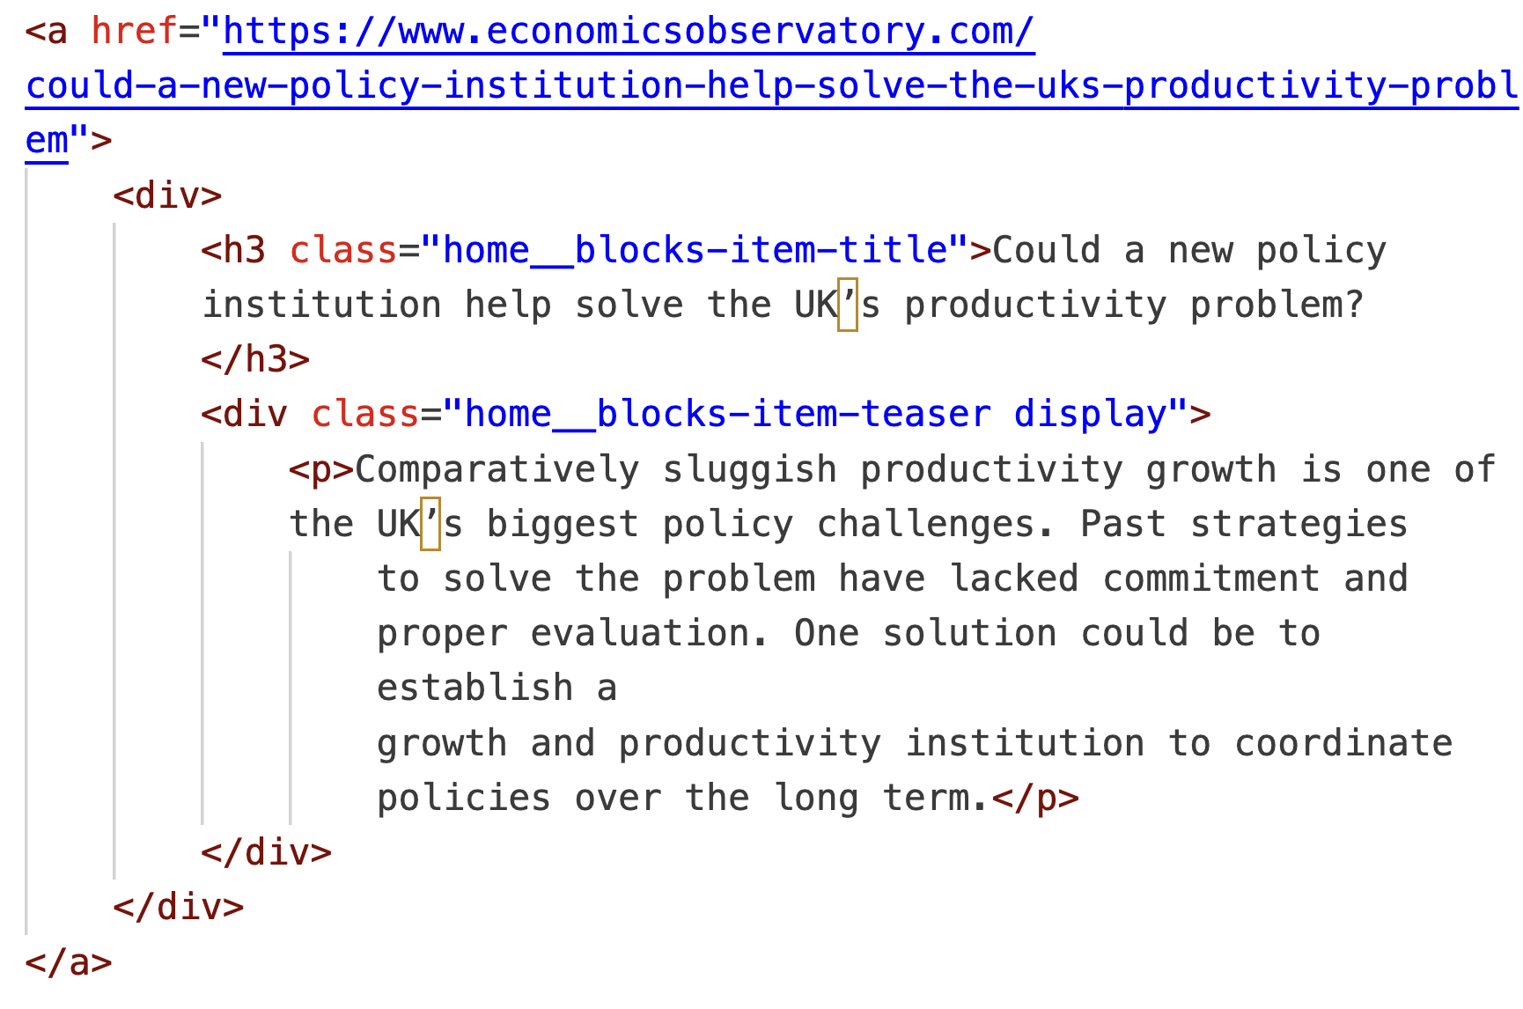
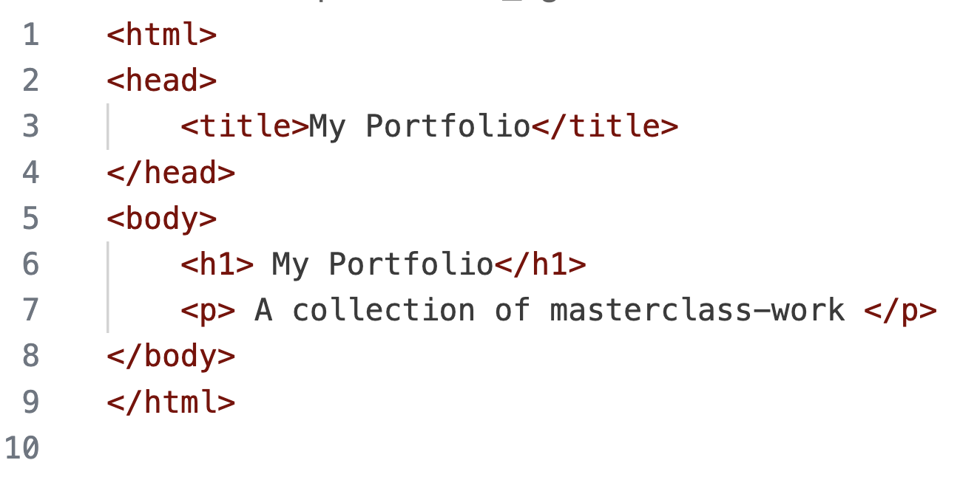
Parsing HTML.
We started today by writing HTML
We’ll end it by reading HTML

Slide 17
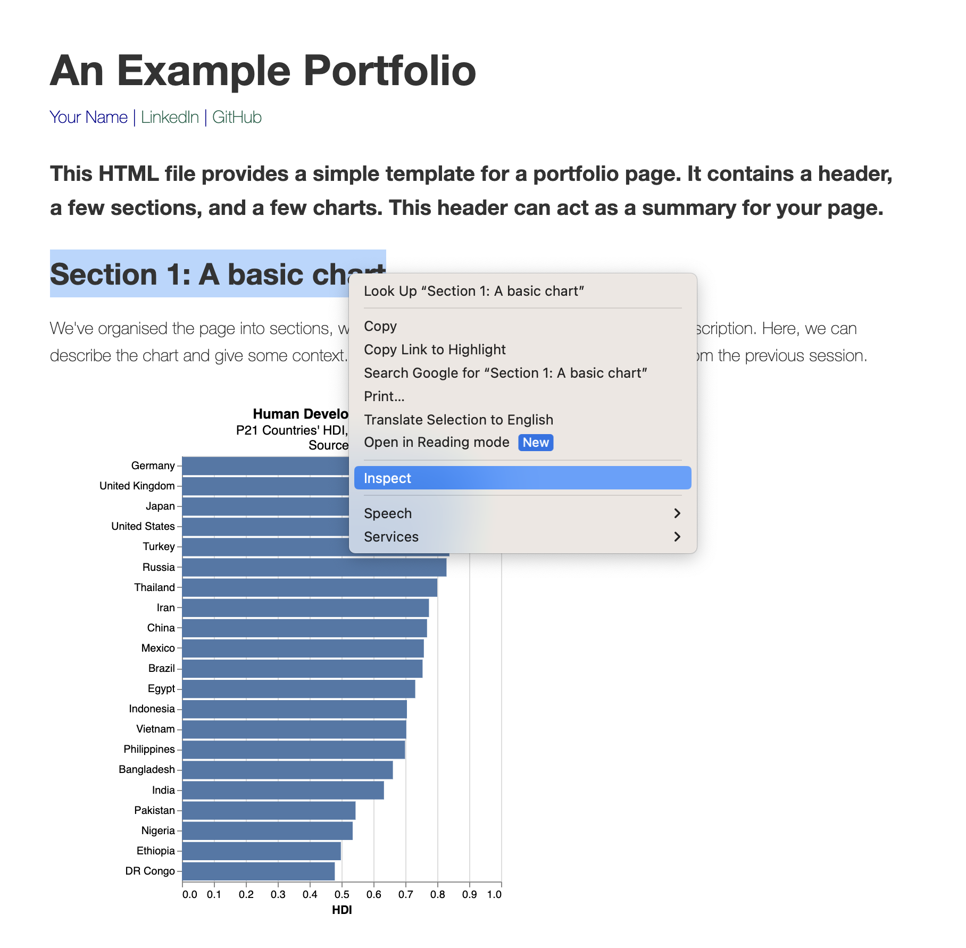
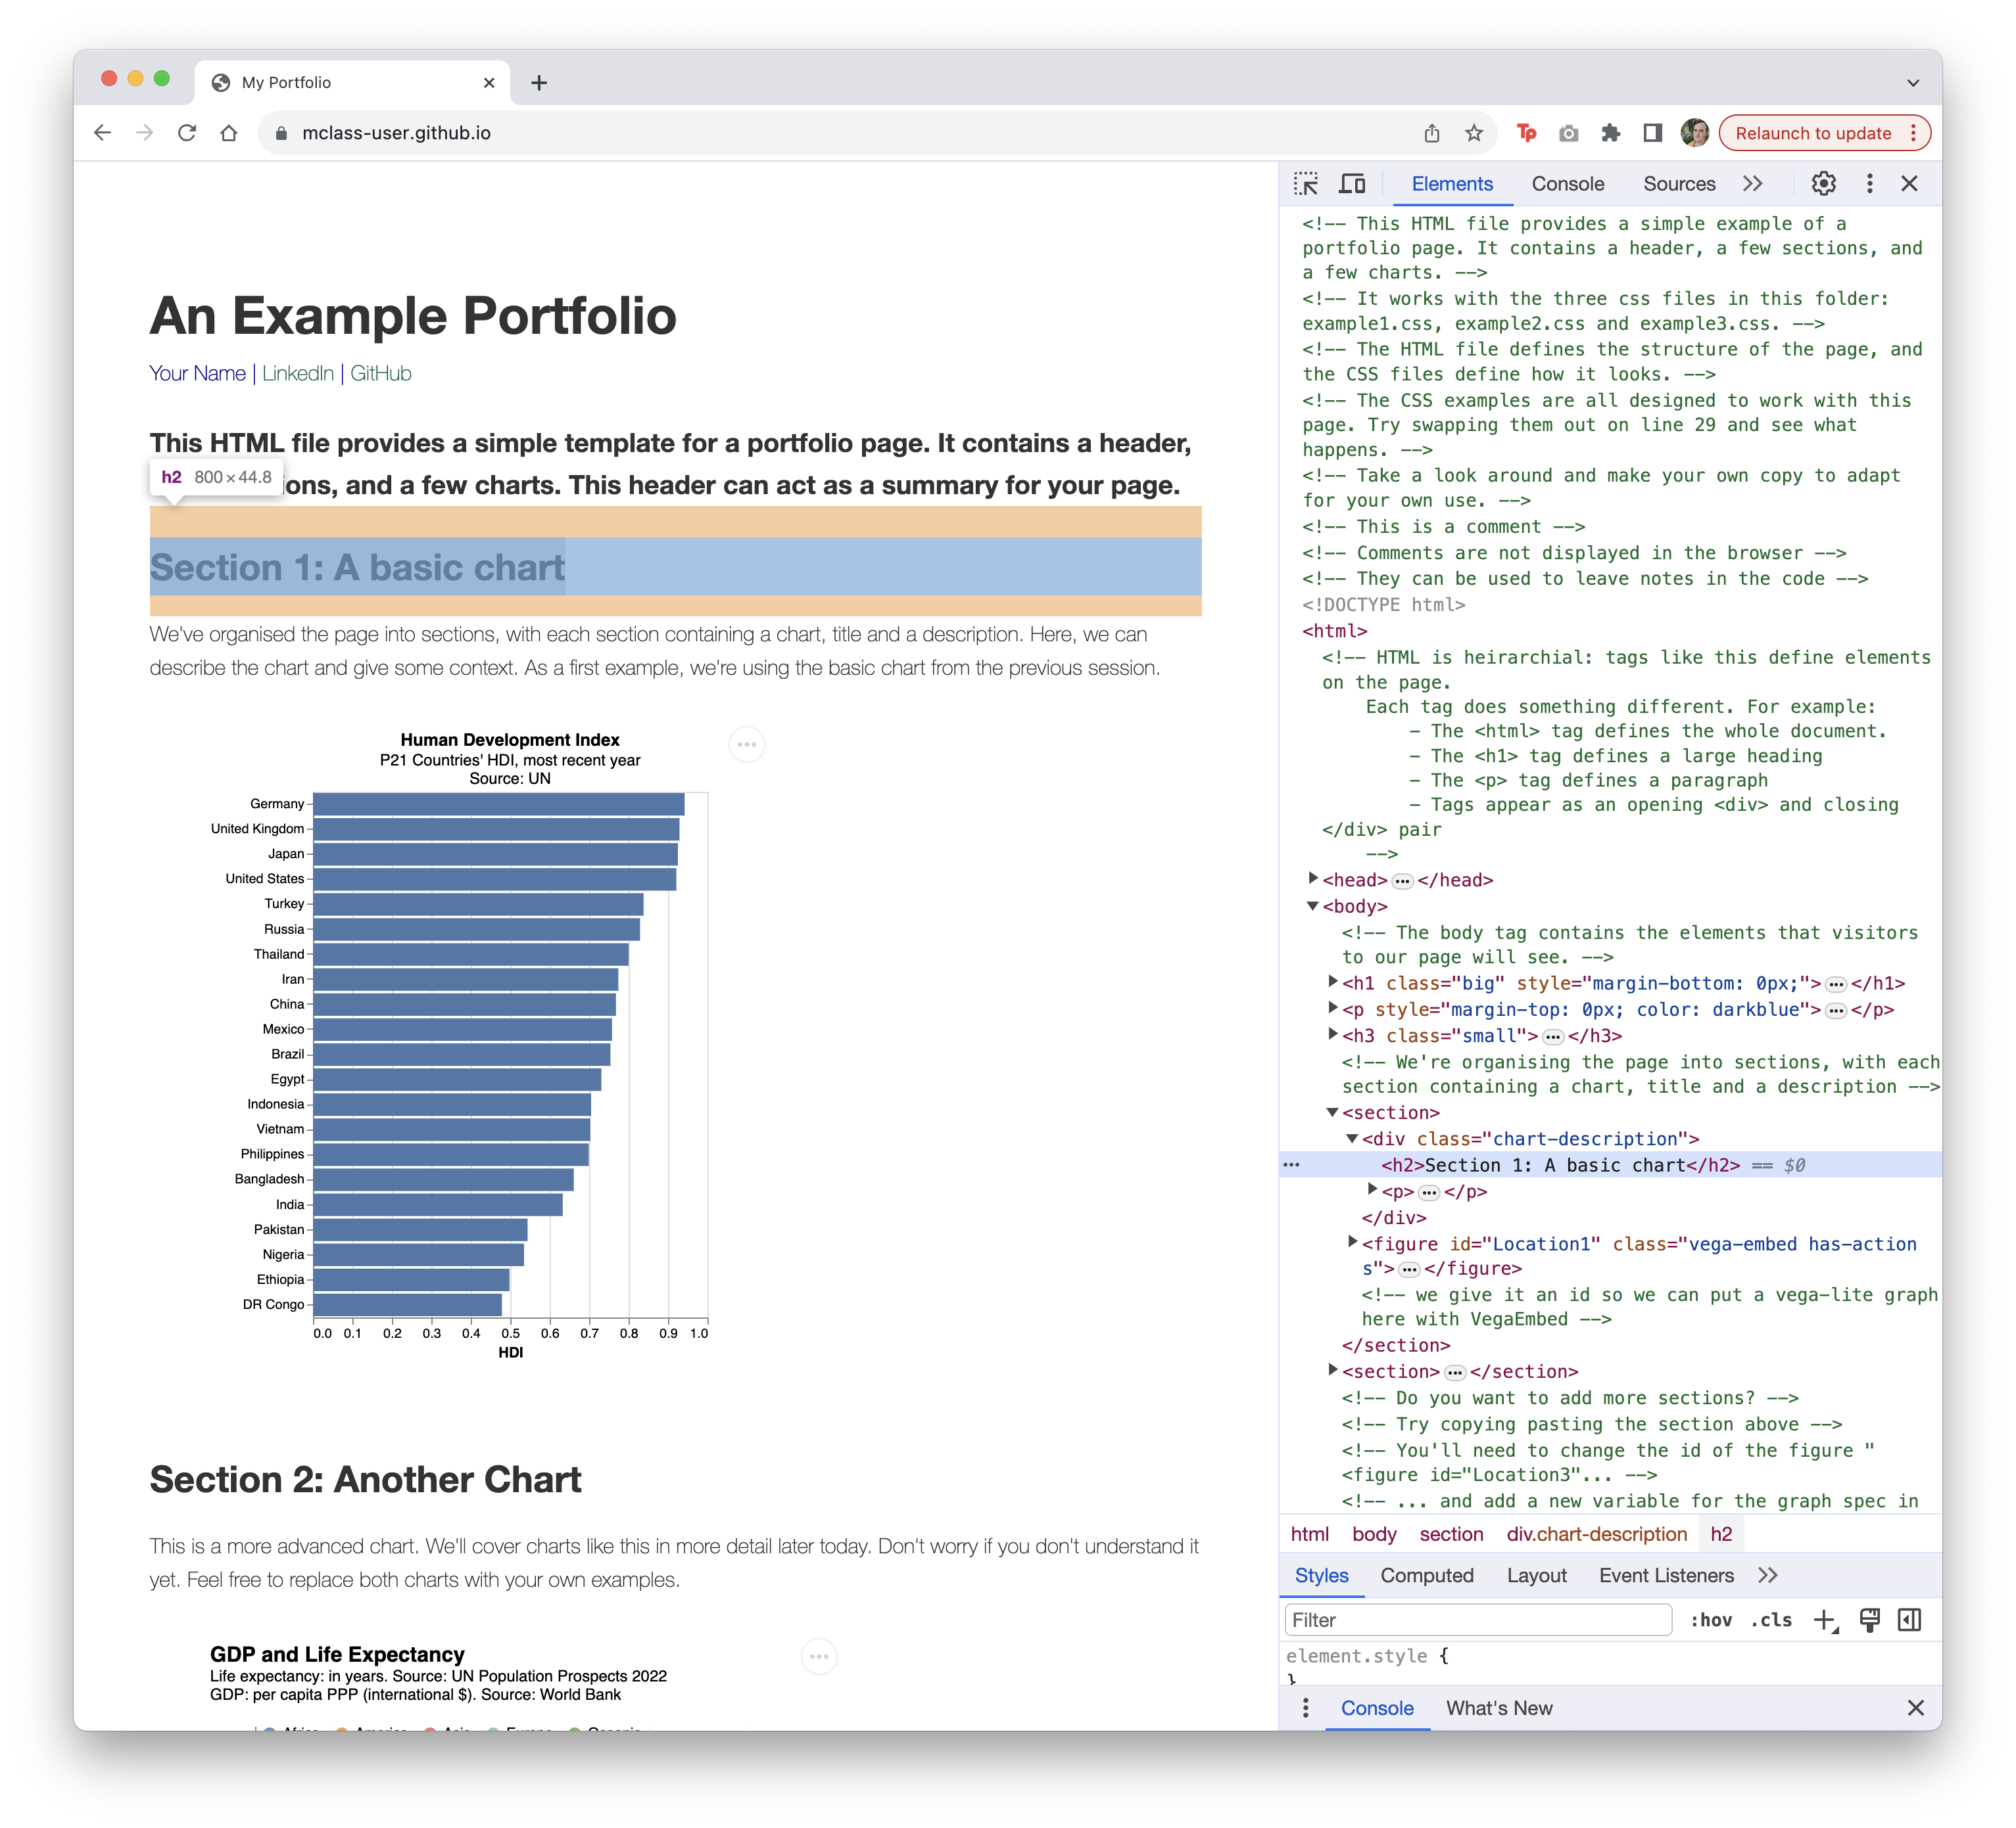
Using Inspect-Element.
Our most important tool is ‘inspect-element’
In Chrome, Right-click or Ctrl. Click and select ‘Inspect’
Notes:
On this page, the HTML (2700 lines long!) defines the page we see

Slide 18
Parsing HTML.
(Almost) all the data displayed on websites is found in the HTML
We can extract data by searching the HTML
Everything is defined in the HTML, we just have to find it

Slide 19
Overview.
Determine how data is defined in HTML (inspect element)
Parse the HTML (Beautiful Soup)
Clean the data (Pandas)
Visualise (Vega-lite)

Slide 20
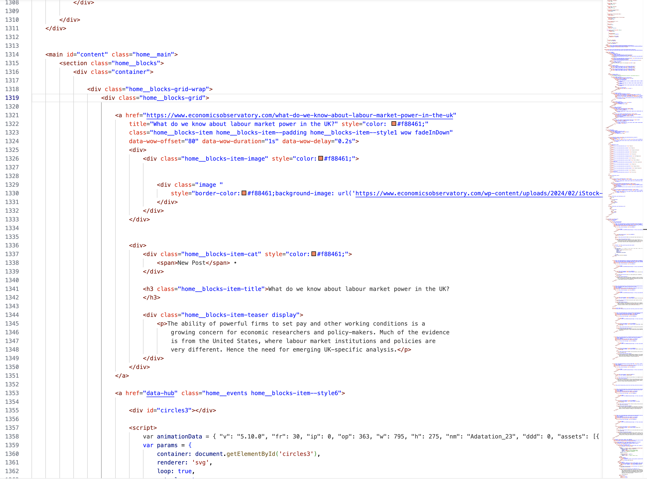
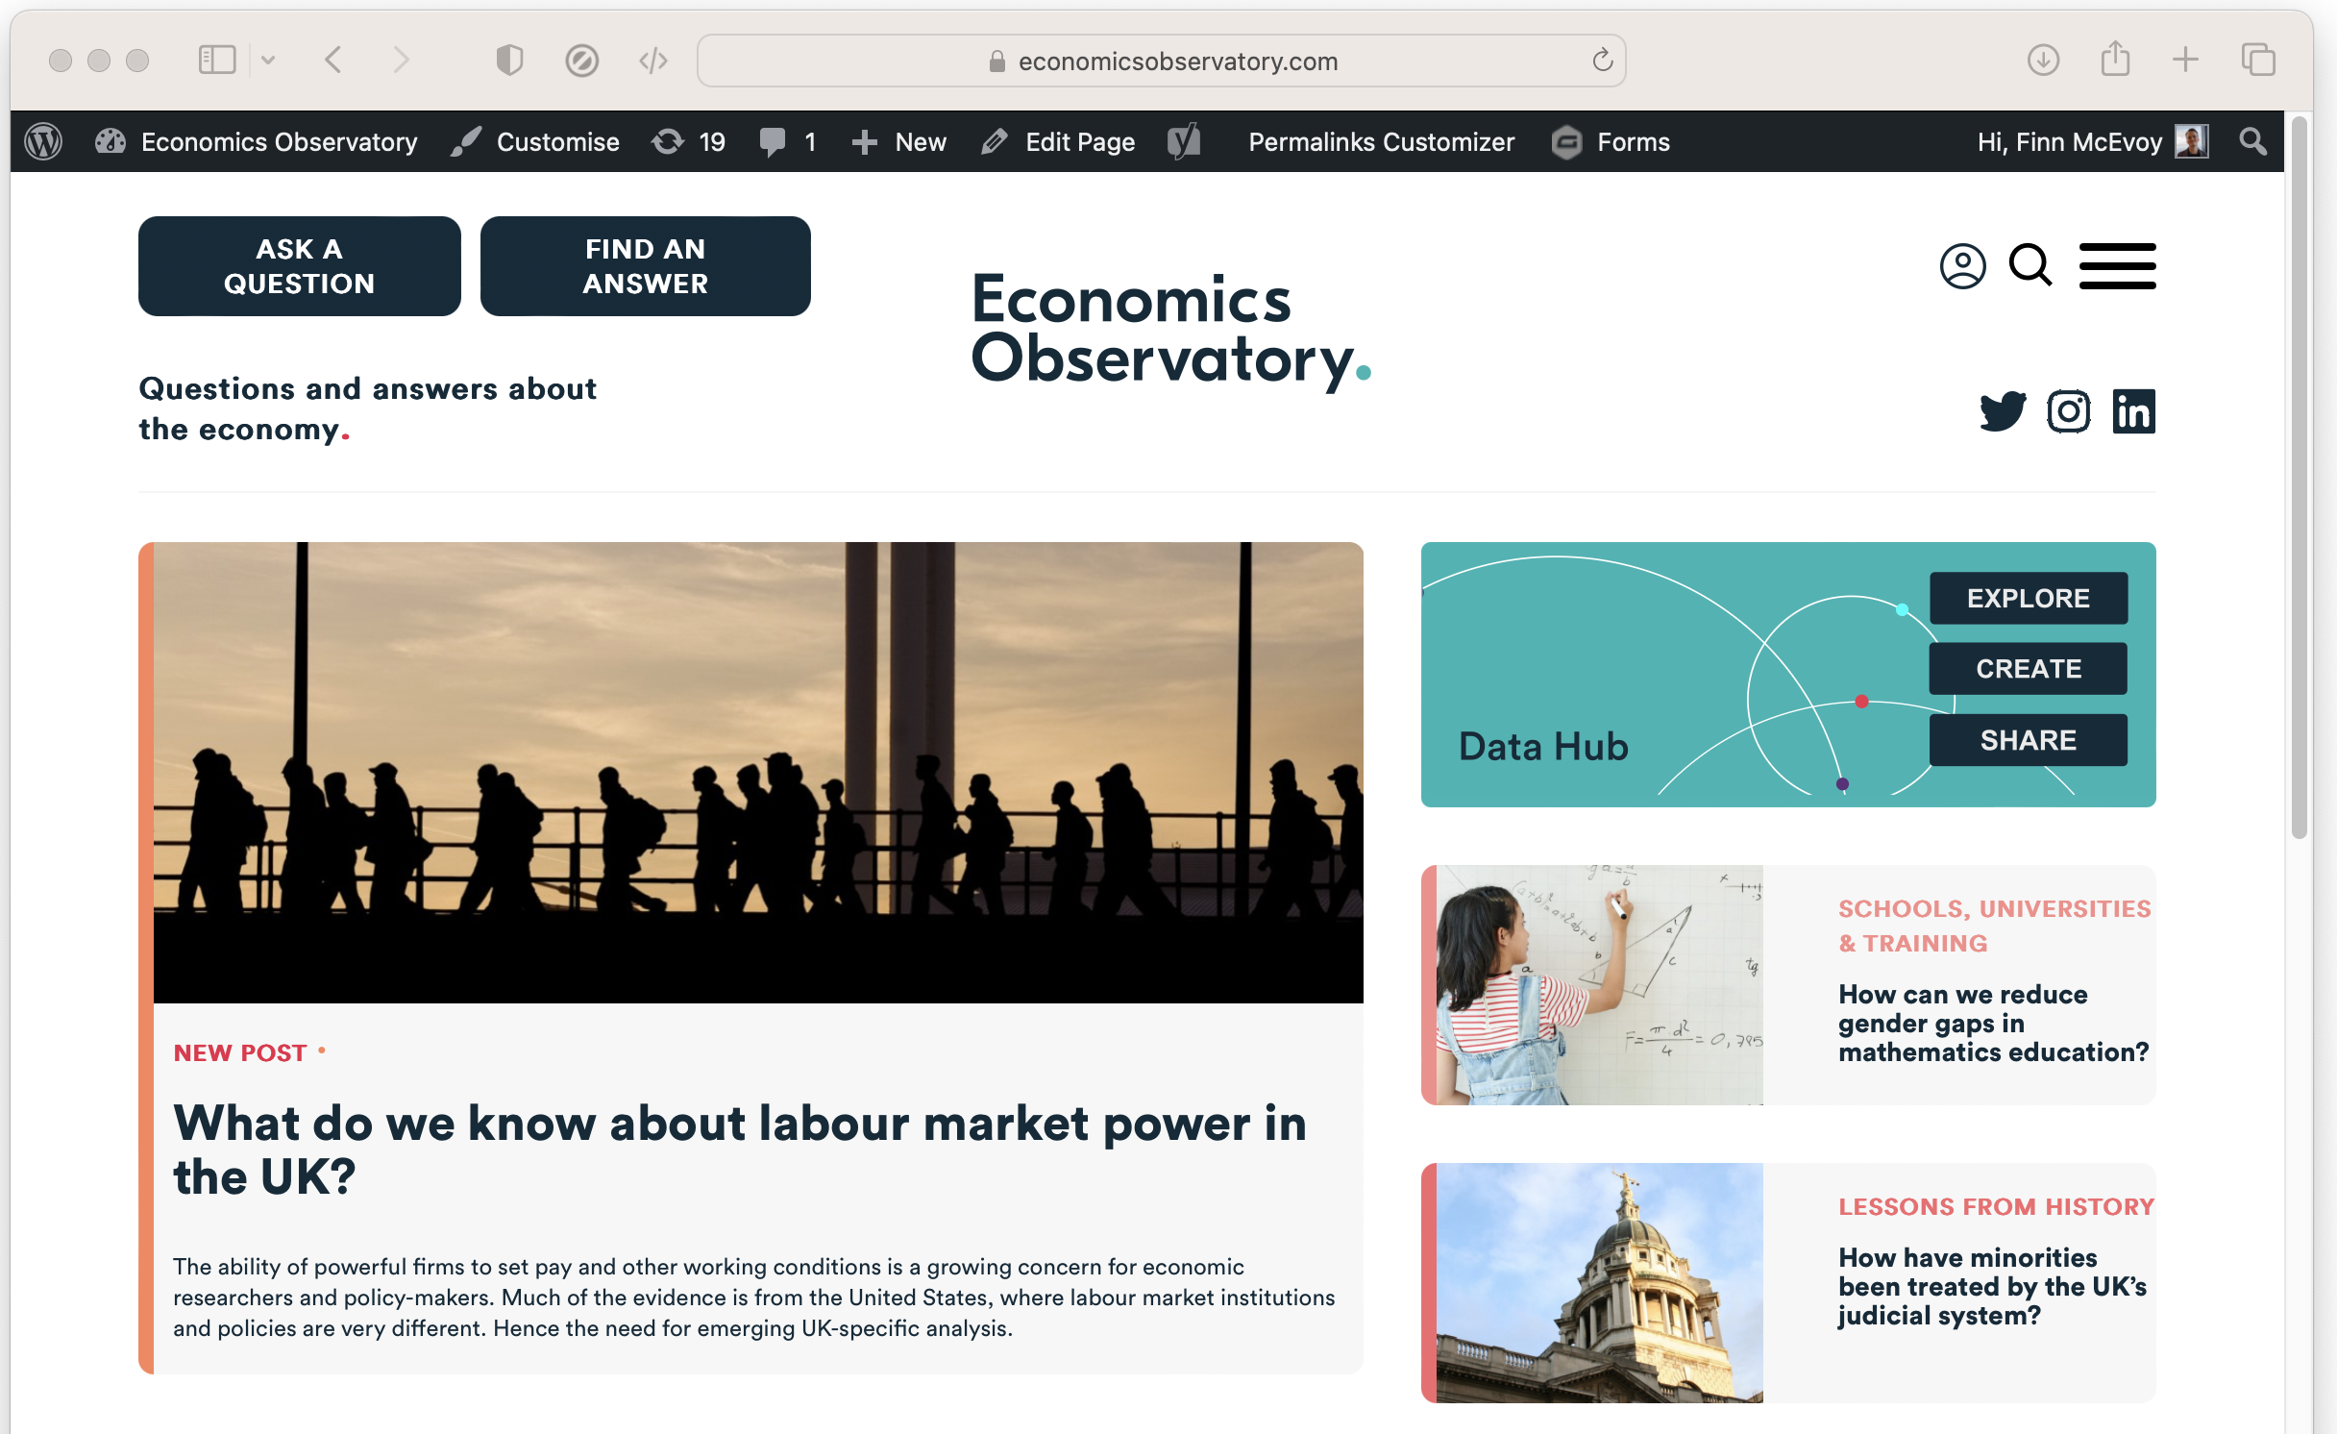
An Example.
For example, we can scrape ECO headlines and tag-lines by ‘parsing’ the HTML
Notes:
On this page, the HTML (2700 lines long!) defines the page we see

Slide 21
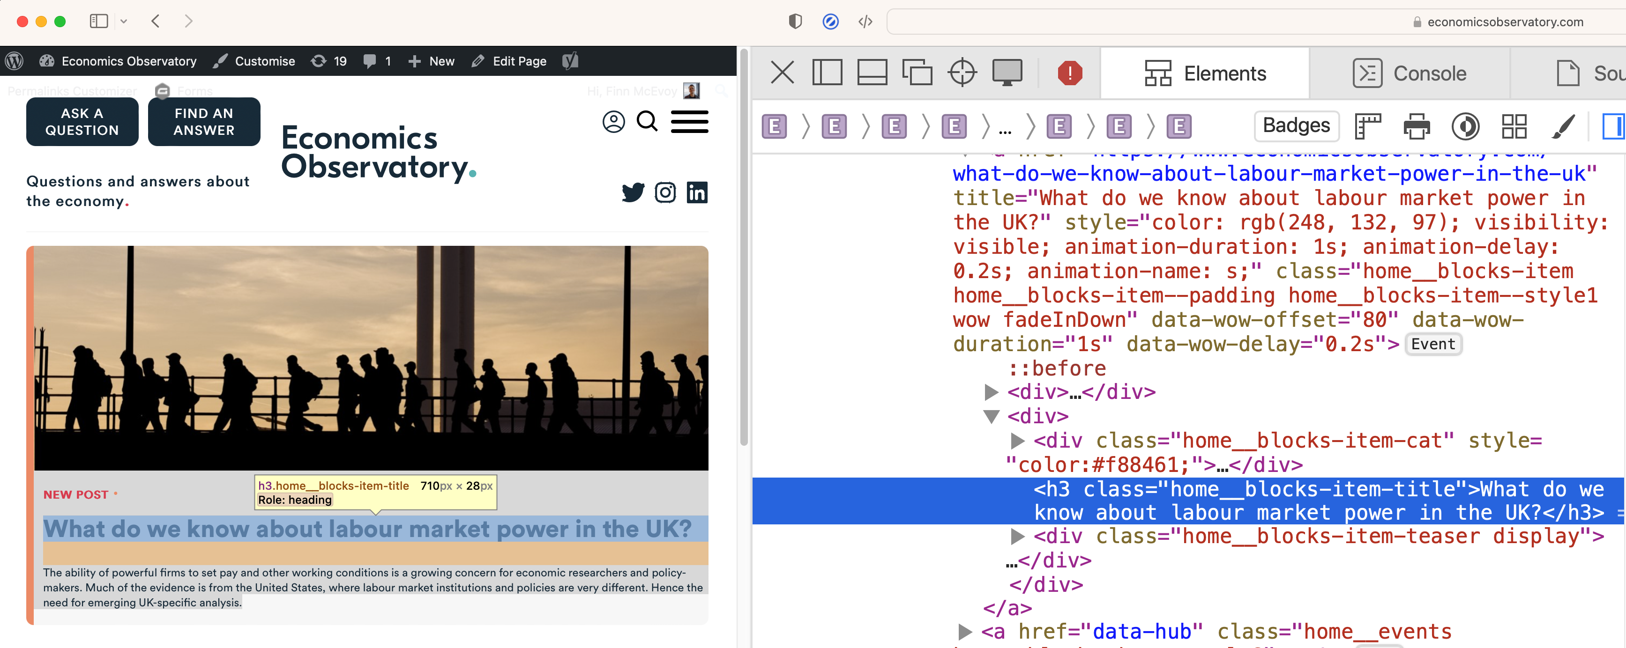
Using Inspect-Element.
We determine how the target data is defined using ‘inspect-element’
We see titles have a class “home_blocks-item-title”
Notes:
On this page, the HTML (2700 lines long!) defines the page we see

Slide 22
Parse the HTML
We’ll use use a Python module, BeautifulSoup, to interpret the HTML.
For example, we can look for every title by searching for:
class “home_blocks-item-title”
with
soup.find_all(class_="home__blocks-item-title")
Notes:
On this page, the HTML (2700 lines long!) defines the page we see

Slide 23
Code-along. A more advanced scraper
In this bonus practical session, we will use Google Colab to use scrape data from the Economics Observatory website using Python. Again, we can also embed a chart displaying the scraped data into your website, using VS Code and GitHub.
Work through the following guided notebook: “s5_Scraping.ipynb” (open in Google Colab)

Slide 24
Learn more.
In this session we have tried basic data scraping with BeautifulSoup
There’s still much more to learn
Choose your own projects (how can you make your job easier?)
Try bigger projects (scrape 100 pages, not just 1)
Try advanced tools (e.g. Selenium)
Notes:
On this page, the HTML (2700 lines long!) defines the page we see

Slide 25
Learn more, responsibly.
Rate-limiting: avoid making too many requests at once
Ethics: Ensure your scraping activities do not harm the website's operation
Data Privacy: Be mindful of personal data collection. Comply with relevant data protection laws (like GDPR).
Notes:
On this page, the HTML (2700 lines long!) defines the page we see

Slide 26
Workshop 4. Accessing data programmatically
Code-along and automated data access

Slide 27
Workshop 4. Accessing data programmatically
https://economicsobservatory.com/modern-data-visualisation

Slide 28
Code-along.
In this third practical session, we will be using Google Colab
Quick introduction to loops.
Using a loop with an API to create multiple charts.
Pick you best chart and embed in your site.

Slide 29
Extra slides: Background.

Slide 30
Background. The similarity of programming languages

Slide 31
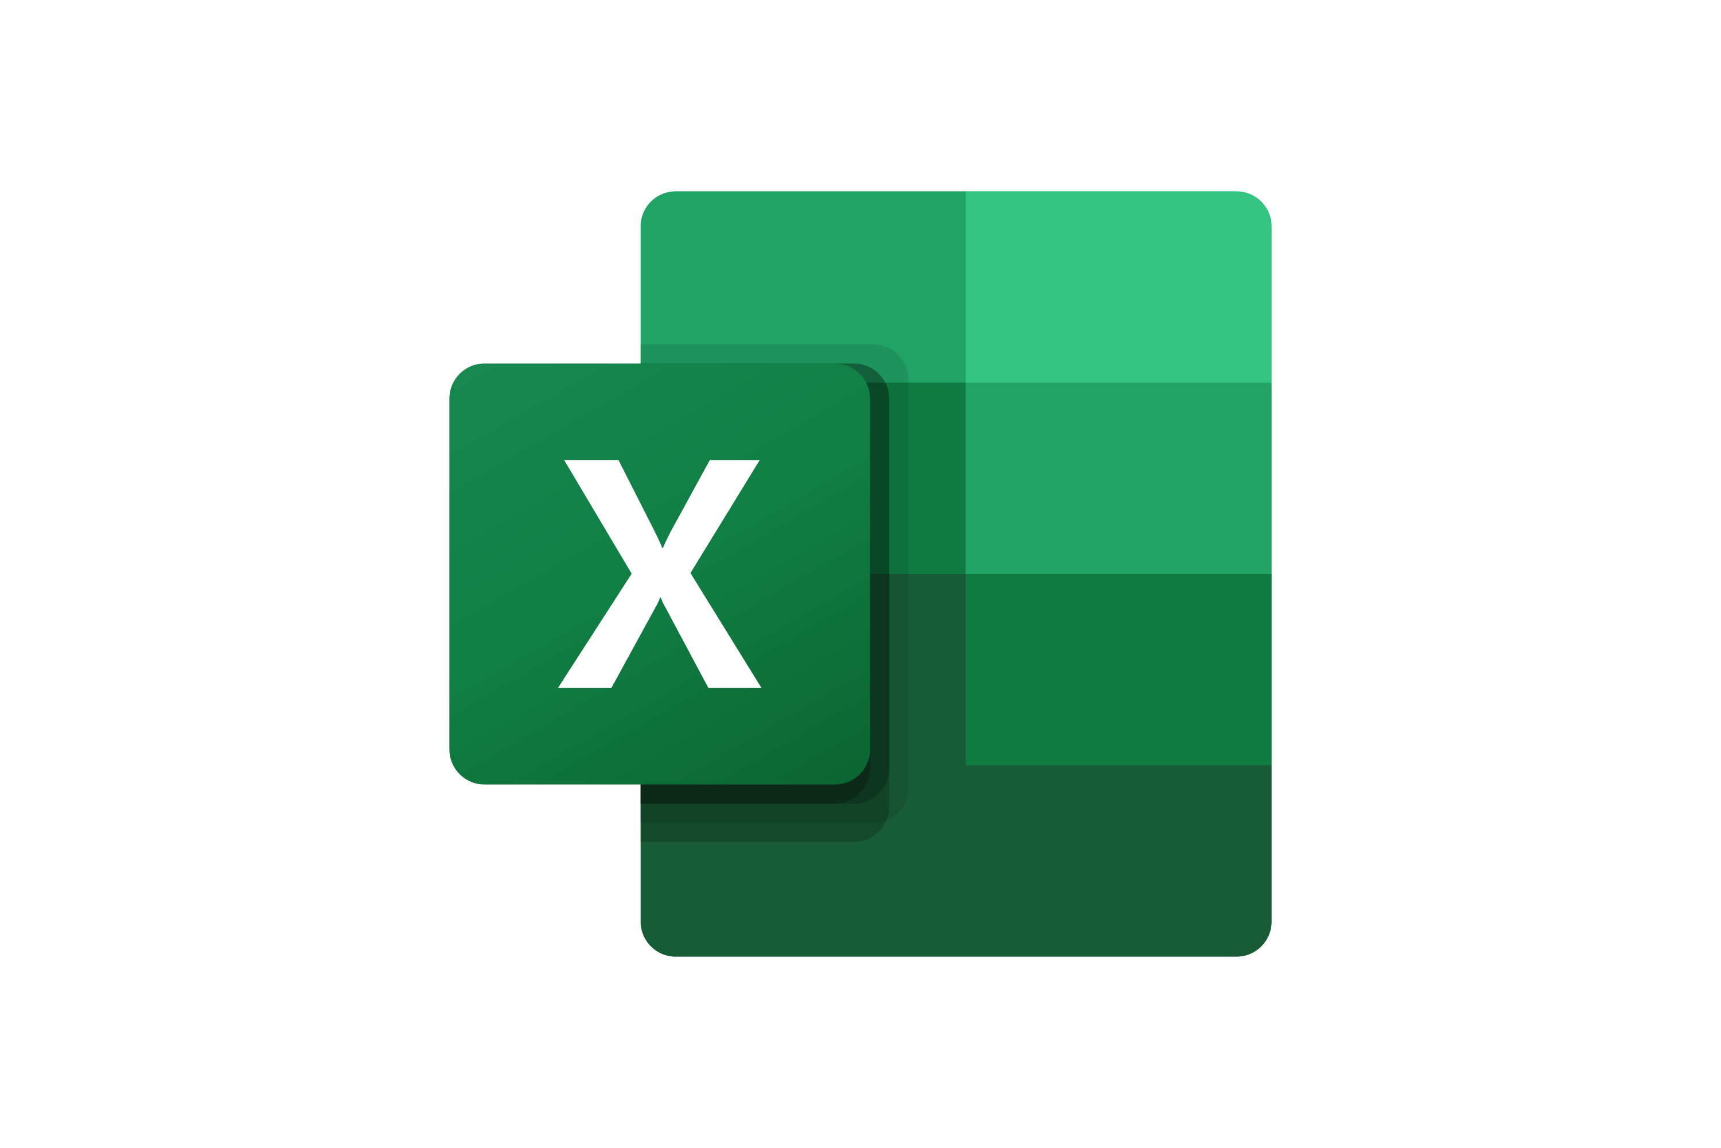




How many languages?
Five?

Slide 32
How many languages?
Three?

